Slide 1

Comparing ANCOVA and Constrained Longitudinal
Data Analysis for Examining Moderators in Randomized Clinical Trials
Joseph R. Rausch
Nationwide Children’s Hospital, Center for Biobehavioral Health
Department of Pediatrics, OSU College of Medicine
2020 Society for Clinical Trials Annual Conference
July 30, 2020

Slide 2
Introduction
Many recommend ANCOVA to analyze RCTs
Useful with pre-specified covariates (often includes Pretest)
Often works well with no missing outcome data
Not necessarily optimal when outcome data are missing (list-wise deletion)

Slide 3
Approaches for Missing Data
Two commonly accepted approaches under assumption of missing at random
Multiple Imputation (MI) and Maximum Likelihood Estimation (MLE)
For our purposes, we focus on MLE
Thus, need model similar/analogous to ANCOVA based on MLE

Slide 4
Approaches for Missing Data
Specifically, we focus on what some have referred to as constrained longitudinal data analysis (cLDA; Liang & Zeger, 2000)
cLDA is an approach to longitudinal data analysis that can be considered a mixed-effects model
Could be estimated used the MIXED procedure in SAS, for example
Other software packages could likely be used as well

Slide 5
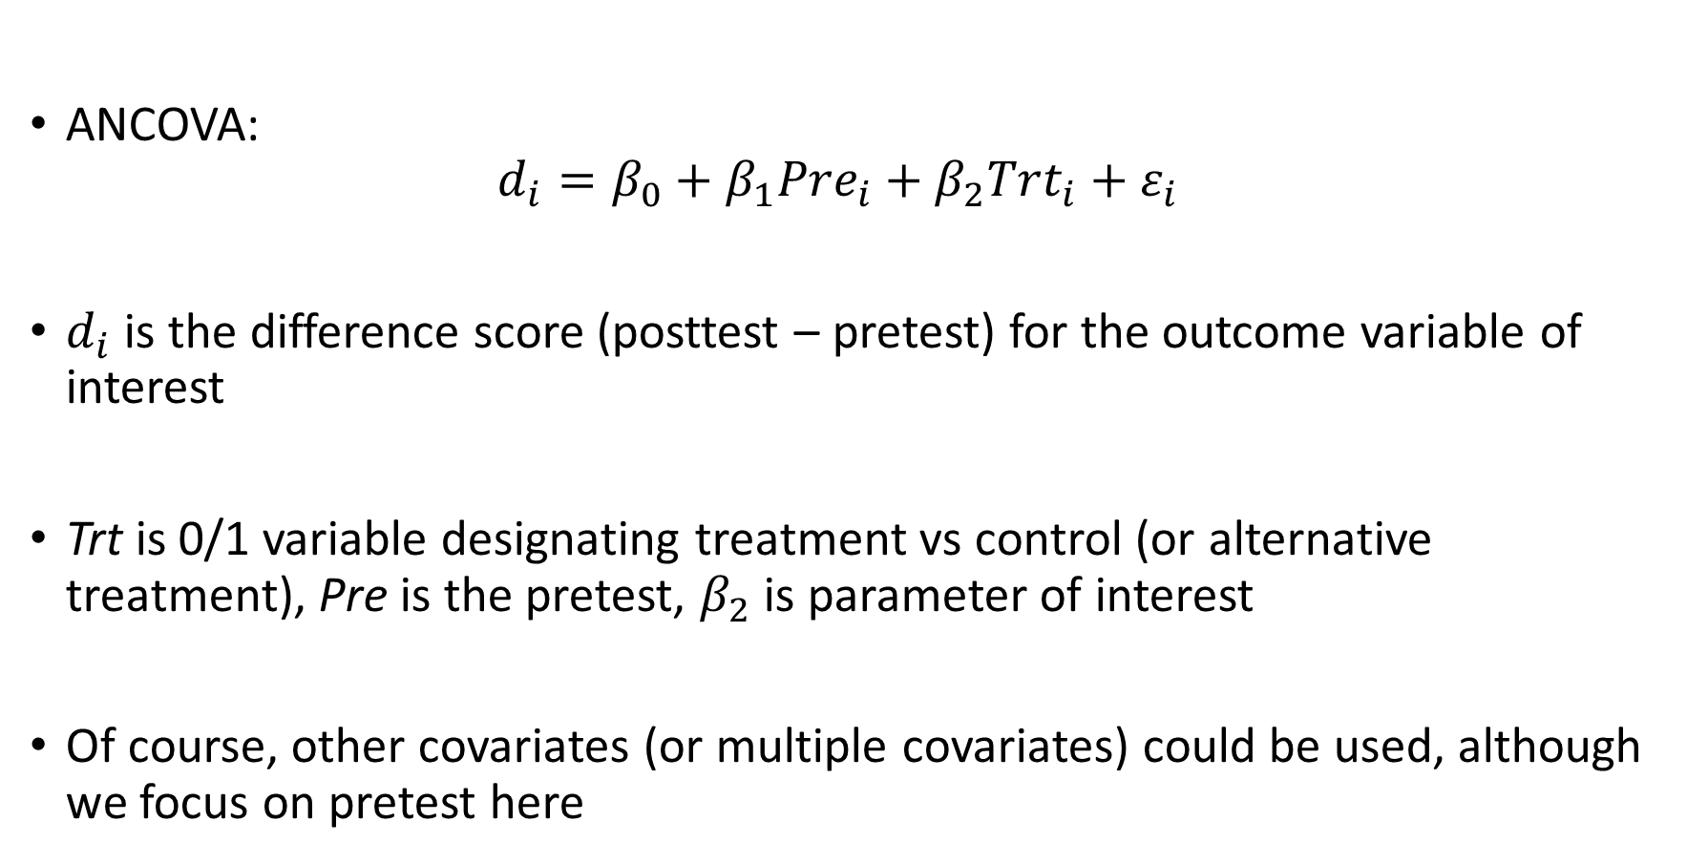
ANCOVA: Average Treatment Effect
Randomization Procedures: Simple Randomization
ANCOVA:
$$d_{i}=β_{0}+β_{1}{Pre}_{i}+β_{2}{Trt}_{i}+ε_{i}$$
$d_{i}$ is the difference score (posttest – pretest) for the outcome variable of interest
Trt is 0/1 variable designating treatment vs control (or alternative treatment), Pre is the pretest, $β_{2}$ is parameter of interest
Of course, other covariates (or multiple covariates) could be used, although we focus on pretest here

Slide 6
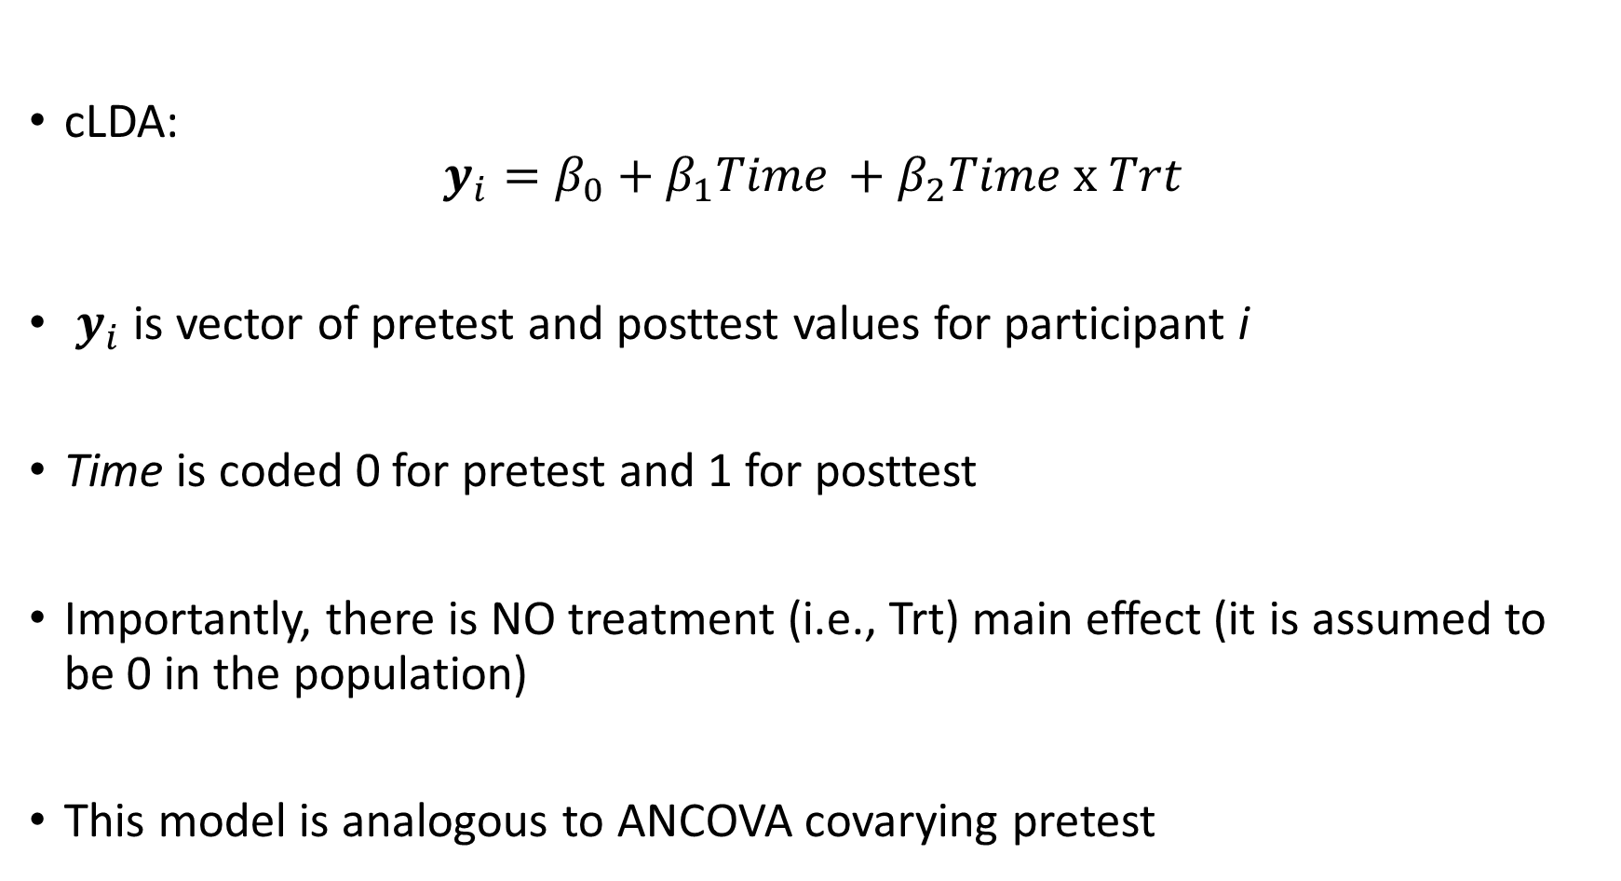
cLDA: Average Treatment Effect
Randomization Procedures: Simple Randomization
cLDA:
$$y_{i}=β_{0}+β_{1}{Time}_{ }+β_{2}{Time x Trt}_{ }$$
$y_{i}$ is vector of pretest and posttest values for participant i
Time is coded 0 for pretest and 1 for posttest
Importantly, there is NO treatment (i.e., Trt) main effect (it is assumed to be 0 in the population)
This model is analogous to ANCOVA covarying pretest

Slide 7
ANCOVA vs cLDA: Average Treatment Effect
Randomization Procedures: Simple Randomization
Previous research has shown these two approaches yield identical parameter estimates for the RCT group difference when no data are missing
The standard errors for the two models are generally different due to the different underlying assumptions of the models
However, with no missing data the standard errors are often similar
With missing data, the cLDA is generally considered a less biased and more efficient approach for testing and estimating the average treatment effect
Lu (2010), Liu et al (2009), Winkens et al (2007)

Slide 8
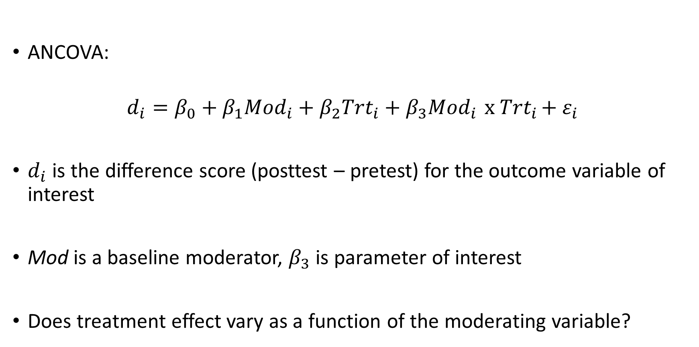
ANCOVA: Moderator
Randomization Procedures: Simple Randomization
ANCOVA:
$$d_{i}=β_{0}+β_{1}{Mod}_{i}+β_{2}{Trt}_{i}+β_{3}{Mod}_{i}{ x Trt}_{i}+ε_{i}$$
$d_{i}$ is the difference score (posttest – pretest) for the outcome variable of interest
Mod is a baseline moderator, $β_{3}$ is parameter of interest
Does treatment effect vary as a function of the moderating variable?

Slide 9
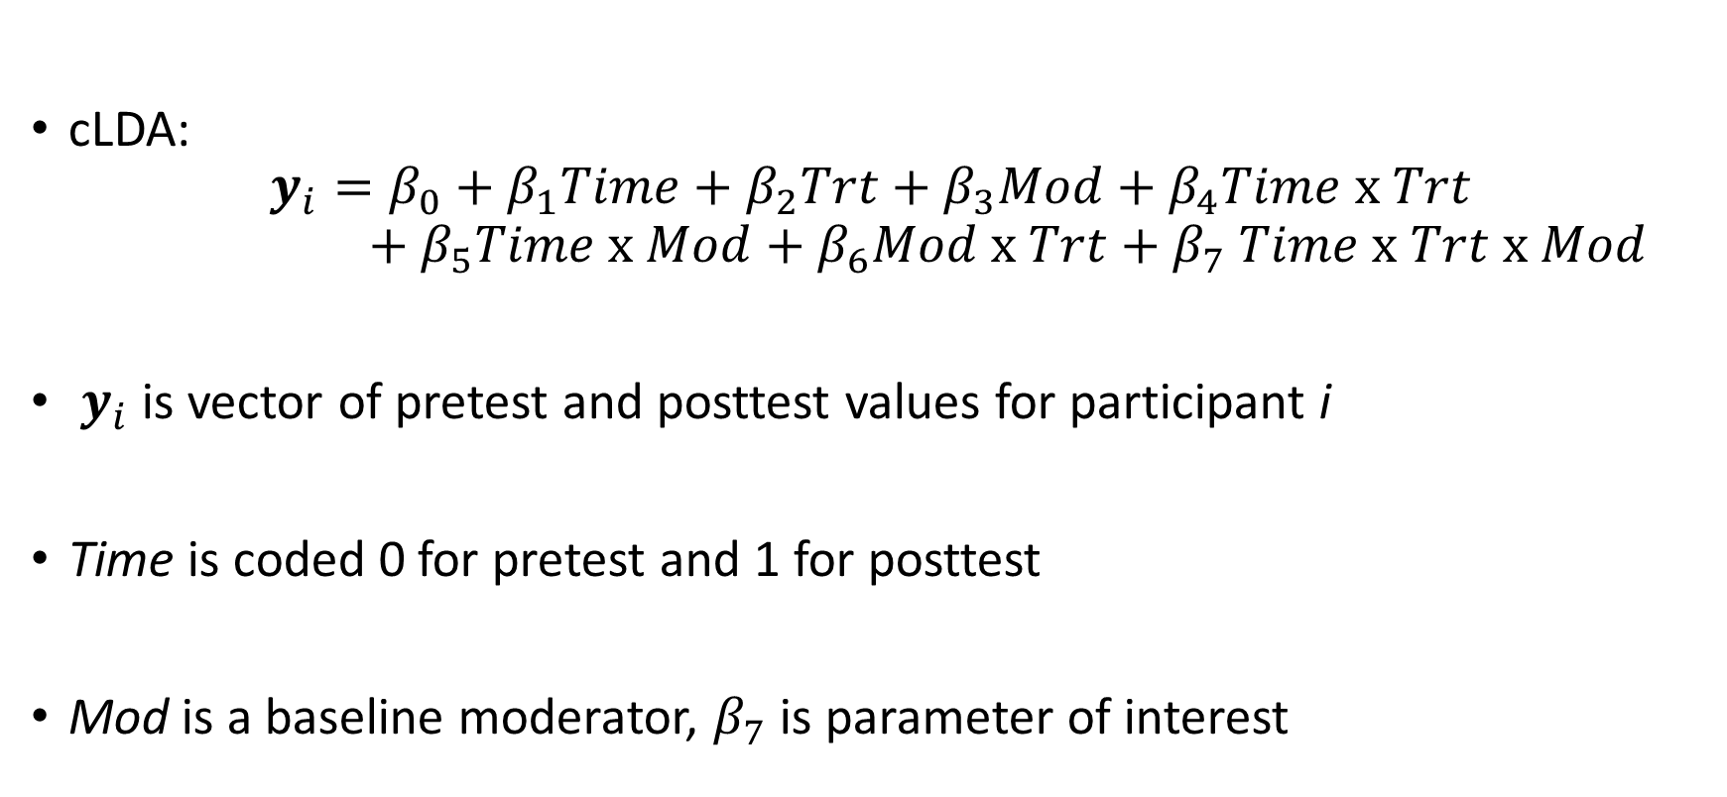
cLDA: Moderator
Randomization Procedures: Simple Randomization
cLDA:
$$y_{i}=β_{0}+β_{1}Time+β_{2}Trt+β_{3}Mod+β_{4}Time x Trt$$
$$+ β_{5}Time x Mod+β_{6}Mod x Trt{+ β}_{7}Time x Trt x Mod$$
$y_{i}$ is vector of pretest and posttest values for participant i
Time is coded 0 for pretest and 1 for posttest
Mod is a baseline moderator, $β_{7}$ is parameter of interest

Slide 10
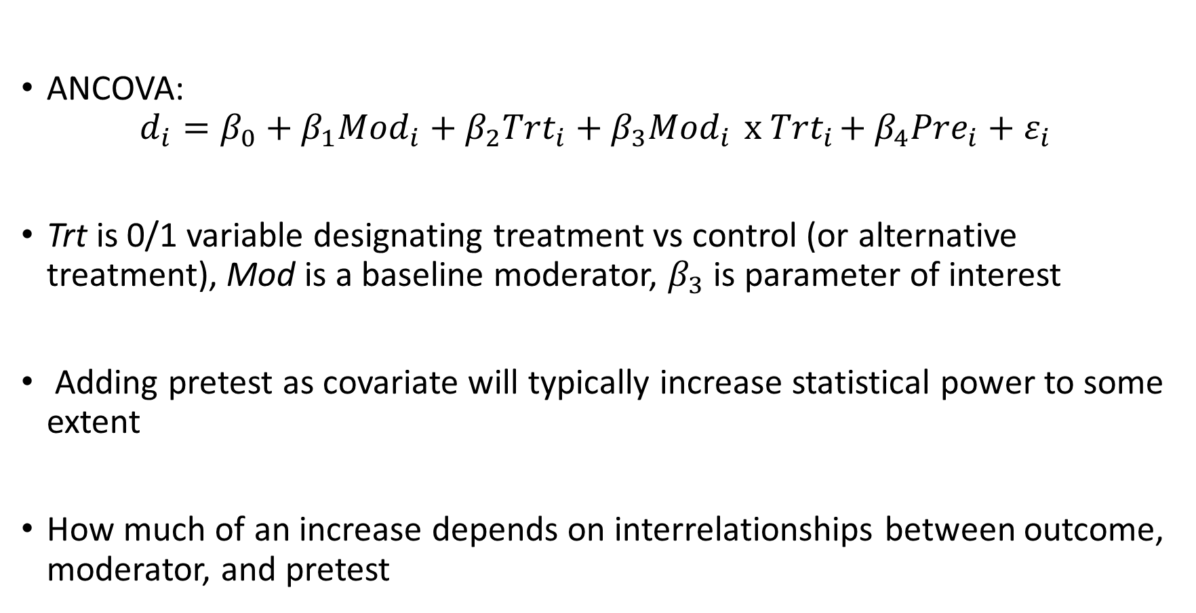
ANCOVA: Moderator, Pretest as Covariate
Randomization Procedures: Simple Randomization
ANCOVA:
$$d_{i}=β_{0}+β_{1}{Mod}_{i}+β_{2}{Trt}_{i}+β_{3}{Mod}_{i}{ x Trt}_{i}+β_{4}{Pre}_{i}+ε_{i}$$
Trt is 0/1 variable designating treatment vs control (or alternative treatment), Mod is a baseline moderator, $β_{3}$ is parameter of interest
Adding pretest as covariate will typically increase statistical power to some extent
How much of an increase depends on interrelationships between outcome, moderator, and pretest

Slide 11
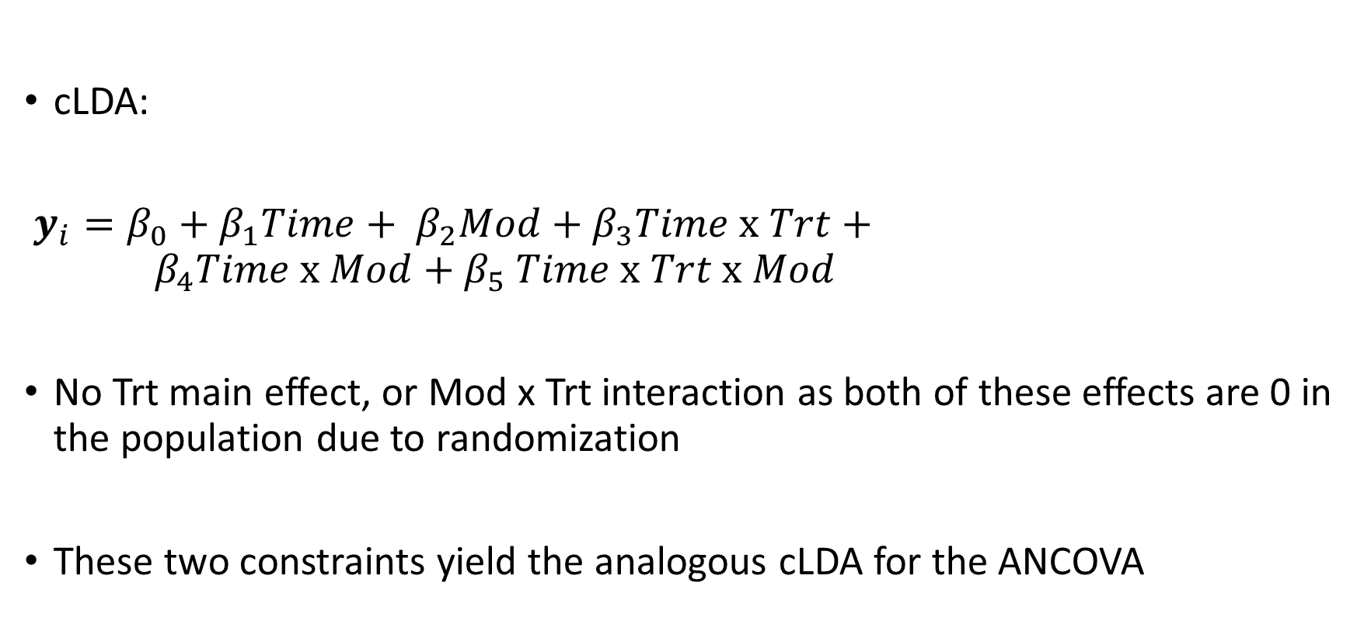
cLDA: Moderator, Pretest as Covariate
Randomization Procedures: Simple Randomization
cLDA:
$y_{i}=β_{0}+β_{1}Time+ β_{2}Mod+β_{3}Time x Trt+ { β}_{4}Time x Mod{+ β}_{5}Time x Trt x Mod$
No Trt main effect, or Mod x Trt interaction as both of these effects are 0 in the population due to randomization
These two constraints yield the analogous cLDA for the ANCOVA

Slide 12

ANCOVA: Pretest as Moderator
Randomization Procedures: Simple Randomization
ANCOVA:
$$d_{i}=β_{0}+β_{1}{Pre}_{i}+β_{2}{Trt}_{i}+β_{3}{Pre}_{i}{ x Trt}_{i}+ε_{i}$$
Trt is 0/1 variable designating treatment vs control (or alternative treatment), Pre is the specific baseline moderator here
Pretest is often good starting point for thinking about potential moderators
One might suspect that there is more potential for treatment effect for those who are initially worse off on the outcome variable

Slide 13
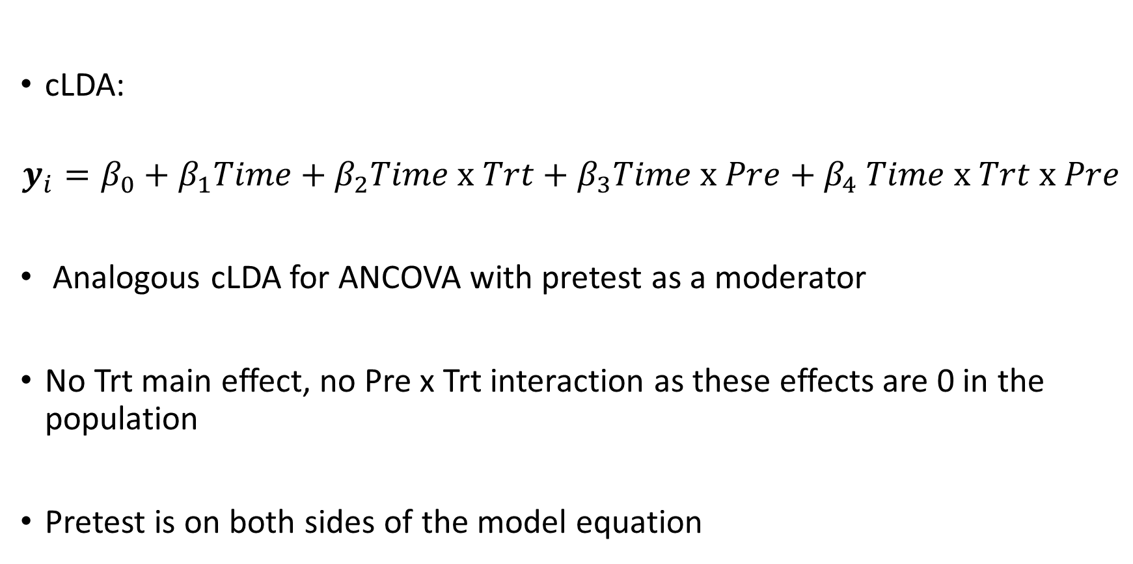
cLDA: Pretest as Moderator
Randomization Procedures: Simple Randomization
cLDA:
$$y_{i}=β_{0}+β_{1}Time+β_{2}Time x Trt+β_{3}Time x Pre{+ β}_{4}Time x Trt x Pre$$
Analogous cLDA for ANCOVA with pretest as a moderator
No Trt main effect, no Pre x Trt interaction as these effects are 0 in the population
Pretest is on both sides of the model equation

Slide 14
Conclusions
With missing outcome data, extensions of ANCOVA are needed
cLDA models haven't been fully described previously for examining moderators, but appear to be promising analytic approach
Still, more research is needed to more fully understand the cLDA approach to examining moderators within RCTs
Could be useful to examine potential differences between MI and MLE in various scenarios

